Slide 1

Super Forecasting Project
Group 8 :
Srija Chillara
Bhagyesh Reddy Bheemireddy
Mariappan Subramanian
Recording : Video

Slide 2
Our Research Questions
Which cricket team will win the 2024 Men’s T20 World Cup Final?
01
What will China’s annual GDP growth rate be for the third quarter of 2024?
02
What percentage of US energy will be generated by solar power in 2025?
03

Slide 3
Executive Summary
Which cricket team will win the 2024 Men’s T20 World Cup Final?
India to win with 21.4% probability
What will China’s annual GDP growth rate be for the third quarter of 2024?
6.04% growth in Q3 with 75% probability
What percentage of US energy will be generated by solar power in 2025?
16% of to come from solar with 75% probability

Slide 4
Which cricket team will win the 2024 Men’s T20 World Cup Final?

Slide 5

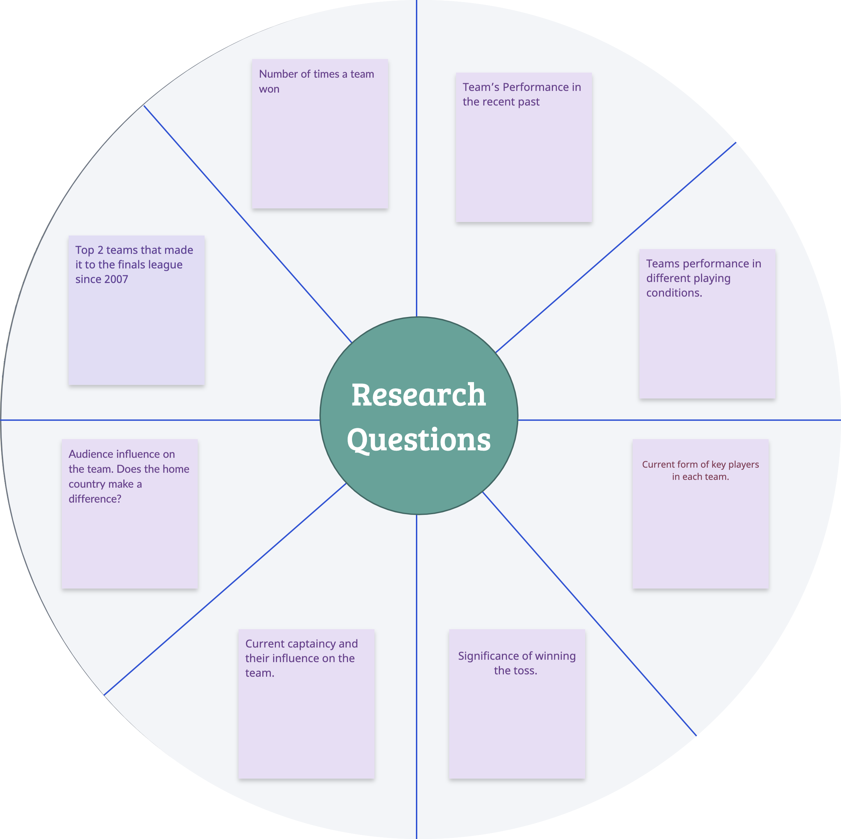
Research Structure

Slide 6
Initial Estimate of the Prior
2007
India
2009
Pakistan
2010
England
2012
West Indies
2014
Sri Lanka
2016
West Indies
2021
Australia
2022
England
Winners through the years
Country Name | No. of times the country won in world Cup | Probability
India | 1 | 13%
Australia | 1 | 13%
West Indies | 2 | 25%
Pakistan | 1 | 13%
England | 2 | 25%
Sri Lanka | 1 | 13%

Slide 7
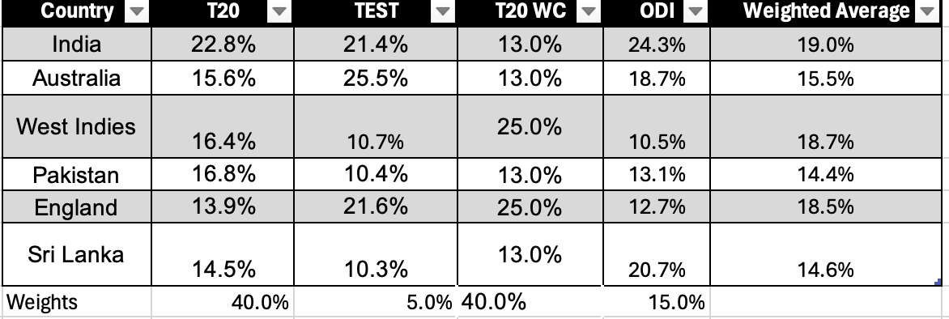
Probability of winning as per match formats
¹ https://www.sportingnews.com/in/cricket/news/who-will-win-t20-world-cup-2024-predictions-chances-betting-odds-favourites/7ca3ba7a7ec7aeff3fb05d08
² https://www.msn.com/en-in/news/other/t20-world-cup-2024-suryakumar-yadav-s-batting-form-key-as-team-india-look-to-end-11-year-icc-title-drought/ar-BB1m1Z9m

Slide 8
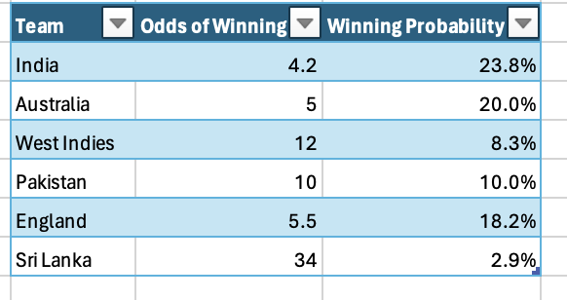
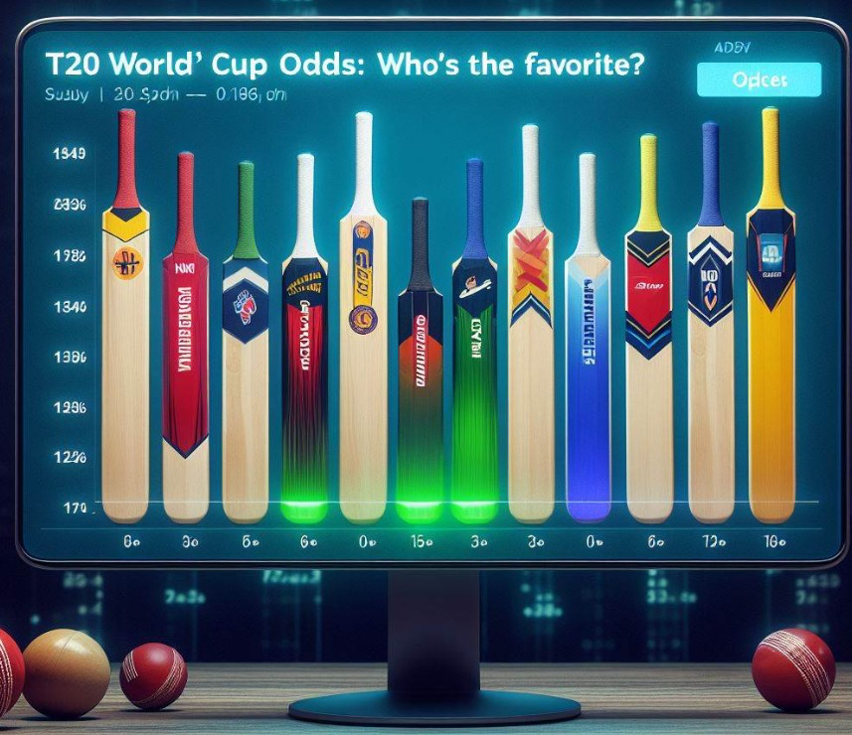
Odds of Winning
¹ https://www.covers.com/cricket/cricket-odds-icc-t20-world-cup

Slide 9
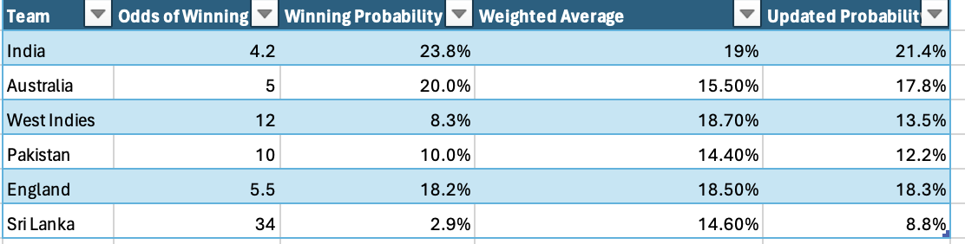
Updated Winning Probability as per both Historical and Recent Performance

Slide 10




Analysis of conditions
Sunny weather increases the probability of a high-scoring game by 15%.
On grassy pitches, the probability that a pace bowler will take 5+ wickets in a match might increase from 10% to 25%.
On dry pitches, the probability of a batsman scoring a century increases by 20%.
In large stadiums, the probability of teams scoring over 200 runs decreases by 15%.
The World Cup being held in the U.S. means that no team has the home advantage, which traditionally levels the playing field somewhat.

Slide 11

The Final Estimate
India has the highest odds of winning the T20 Men’s World Cup 2024
Our calculated prior estimate for India winning is 21.4%

Slide 12
What will China’s annual GDP growth rate be for the third quarter of 2024?

Slide 13
Research Structure
Geopolitical Tensions
What is the impact of the current war situation on GDP?
Technological Innovation and Adoption
Impact of rapid innovation in technology on GDP
Foreign Investment Policies
Attracting foreign investments in the country
Domestic Policies
Internal growth of the country

Slide 14
Year on Year Q3 growth
Years | Q3 Growth Rate
2014 | 7.20%
2015 | 7%
2016 | 6.80%
2017 | 6.90%
2018 | 6.17%
2019 | 5.90%
2020 | 4.80%
2021 | 5.20%
2022 | 3.90%
2023 | 4.90%
2024
With Covid 19 Effect | 5.88%
Pre Covid 19 Effect | 6.81%
Post Covid 19 Effect | 4.94%
Reference1

Slide 15
Final Forecast Calculation
Impact (a) = derived from internet
Sherman Kent’s weight (b) = 30%
Final Probability figure (c) = a * b
Bayesian Prior (d) = average of YoY growth with covid-19 effect consideration
= 5.88%
= 0.0588
Final Forecast = Summation of final probability figures

Slide 16

Geopolitical Tensions
There's a 30% chance that US-China tensions could escalate, harming their relationship.
This could negatively affect China's exports and investor confidence.
Impact = 0.15 * d = 0.0088
Sherman Kent’s weight = 0.3
Probability (P1) = 0.0026
Reference2
Reference3

Slide 17

Technological Innovation
There's a chance that China's focus on technology innovation and digital transformation will stimulate economic growth.
Investments in these sectors could have a positive impact on China's GDP.
Impact = 0.35
Sherman Kent’s Weight = 0.3
Final Probability (P2) = 0.0105
Reference4
Reference5

Slide 18

Foreign Investment
There's a chance that changes in China's foreign investment policies might not boost GDP growth, despite efforts to attract foreign capital.
The uncertainty arises from China's mixed approach to economic openness and its potential impact on growth.
Impact = 0.051
Sherman Kent’s Weight = 0.3
Final Probability (P3) = 0.0153
Reference6

Slide 19

Domestic Policies
There's a 40% chance China will use fiscal stimulus and infrastructure investment to maintain economic stability.
This approach aims to address structural imbalances in the economy.
Impact = 0.03
Sherman Kent’s Weight = 0.3
Final Probability (P4) = 0.009
Reference7

Slide 20
Final Forecast Calculation
Final Forecast = D + P2 + P4 – P1 – P3
= 0.0588 + 0.0105 + 0.009 – 0.002 – 0.015
= 0.0604
= 6.04%

Slide 21
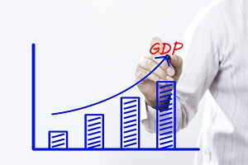
Conclusion
There is 6.04% estimated growth in Q3 GDP.
In other words, there is 75% chance (10% give or take) to get a GDP growth of 6% over the next quarter.

Slide 22
What percentage of US energy will be generated by solar power in 2025?

Slide 23
Research Structure
Deployment Challenges
What are the roadblocks ahead? How they impacts our prior?
4
Latest Policy Landscape
How federal investment push for renewable energy is fueling growth?
3
Historical Industry Growth Rate
What is the pace at which solar industry is growing?
2
Solar Production Current Scenario
What percentage of US energy comes from the solar power?
1
Research Questions - a bottom up approach

Slide 24
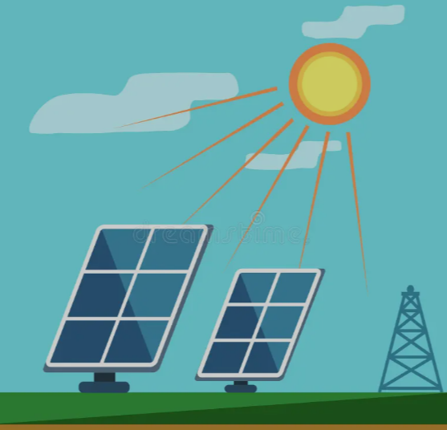

Initial Estimate of the Prior
Current
2023
16% Growth²
Electricity Generated 165K¹ Gigawatt Hours
4% of Total Power Produced
2022
This gives us the initial estimate for our prior probability as 4%. That is, we would expect 4% of total US power generation to come from solar power.
Next, what are the other factors could further refine our initial estimate of 4% ?
¹ Storrow, B., & News, E. (2024). The U.S. Energy Transition Explained in 8 Numbers.
² Lucía Fernández, & 23, A. (2024). U.S. solar power generation 2023

Slide 25
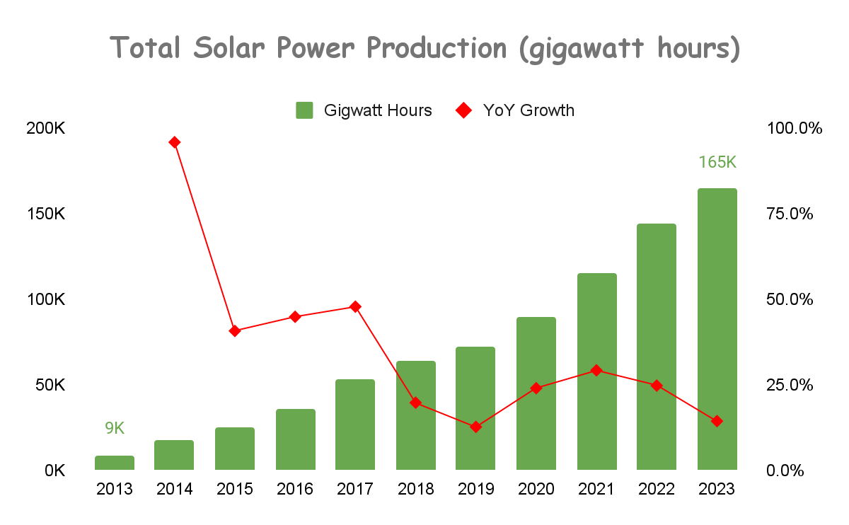

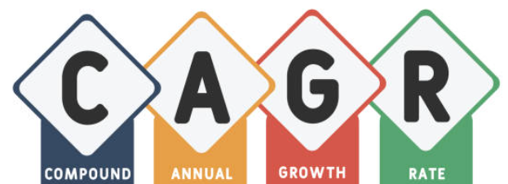
Historical Solar Industry Growth
Decade long
9K to 165K gigawatt hours³
Registering⁴
33.7%
³ Solar Industry Research Data. (n.d.)
⁴ Compound Annual Growth Rate (CAGR) = (165/9)^(1/10) - 1 = 33.7 %

Slide 26
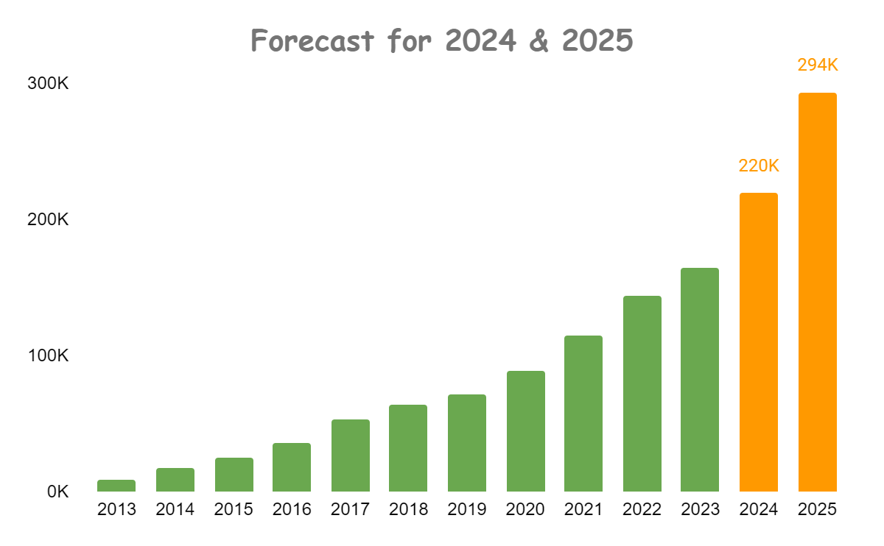
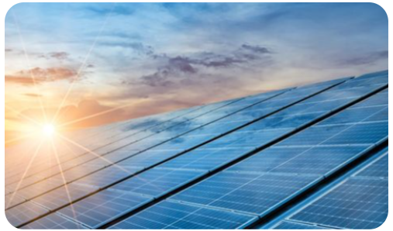
Prior Update - Historical Solar Industry Growth
Let’s update our prior based on the expected growth rate
Prior Update Calculation
Current Prior Estimate * (1 + CAGR)^years
4% * (1.337)^2 = 7.15%
Our prior for solar power share in the US could zoom to
7.15%

Slide 27

Latest Federal Investment Push to Fuel Growth
Inflation Reduction Act of 2022 (IRA) and Infrastructure Investment and Jobs Act (IIJA) of 2021
Represent the largest commitment of the U.S. Federal Government to invest in the modernization and decarbonization of the U.S. energy system
Tax credits, and other incentives authorized through the two laws will exceed $430 billion from 2022 through 2031⁵
⁵ (N.d.). Retrieved from https://www.nrel.gov/docs/fy23osti/85242.pdf

Slide 28
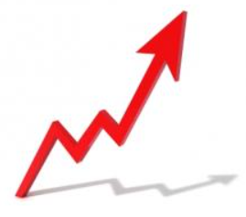
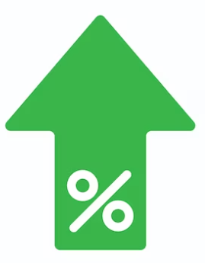
Federal Laws Impact On Solar Deployment and Our Prior
solar deployments to grow rapidly
Historical (2010 - 2022) annual deployment
Update to our Prior
Previous Estimate * (1 + 1.6)
7.15% * 2.6 = 18.6%
43 to 47 GW/year⁵
from 2023 to 2030
160%
⁵ (N.d.). Retrieved from https://www.nrel.gov/docs/fy23osti/85242.pdf

Slide 29
However, there are deployment challenges
Share of clean energy
raising raw materials cost
supply-chain constraints
permitting challenges
challenges ahead
14% drop⁵
social acceptance
constrained transmission development
Final Prior Update
18.6% * (1-.14) = 16%
resources availability
⁵ (N.d.). Retrieved from https://www.nrel.gov/docs/fy23osti/85242.pdf

Slide 30
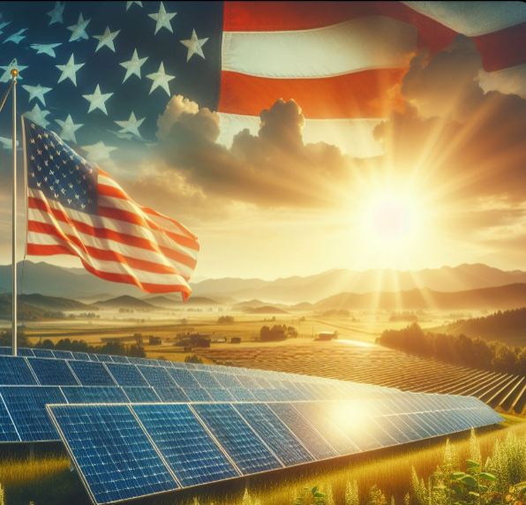
Final Prior Estimate & Uncertainty Around It
16% of US energy is expected to be generated by solar power in 2025
Given strong historical growth rate, federal government’s push for renewable energy, and volatility around deployment, it is probable that 16% of US energy would come from solar
In other words, there is a 75% (give or take about 12%) that solar power would produce 16% of US energy in 2025

Slide 31
THANK YOU

